Slide 1


Network Adequacy
Data Maintenance Planning
PTNP 2026 Round 1 &
Isolated Outlier Provider Location Processing
10:00 am-11:30 am Central
December 16, 2025
Regulatory Health Link Division,
Arkansas Insurance Dept., Dept. of Commerce

Slide 2
Agenda
Introductions & Housekeeping.
Overview of where we are.
Timeline.
PBM Updates.
Provider Address Quality Precheck.
Recap of the Isolated Provider Location Outlier process.
Objection Feedback.
What’s different in the Current Finalized PTNP?
PTNP 2026 Round 1 data maintenance process .
Some observations from the last round.
Significance & Deadlines.
Q&A

Slide 3
Introductions
We try to capture attendee & organization names for the meeting notes.

Slide 4
Intended Audience
AID attempts to communicate with three roles involved in Network Adequacy
NA Subject Matter Expert (NA SME).
Associated IT personnel.
Associated compliance personnel.
NA contacts known to AID are listed and grouped by organizations in Network Adequacy Industry Contact List.pdf on our NA website http://rhld.insurance.arkansas.gov/Default/NetworkAdequacy. Addition or removal of contacts in list can be emailed to RHLD.DataOversight@arkansas.gov

Slide 5
Agenda
Introductions & Housekeeping.
Overview of where we are.
Timeline.
PBM Updates.
Provider Address Quality Precheck.
Recap of the Isolated Provider Location Outlier process.
Objection Feedback.
What’s different in the Current Finalized PTNP?
PTNP 2026 Round 1 data maintenance process .
Some observations from the last round.
Significance & Deadlines.
Q&A

Slide 6
Arkansas Network Adequacy Regulation Cycle
Isolated Outlier Provider Location Review
Plan Certification Review
(SERFF)
Response to Objections
(SERFF)
2026
PTNP Data Maintenance
(Round 2)
Continued NA Review
2026
PTNP Data Maintenance
(Round1)
Start of cycle. We are here.
Coming March
Process pulled out from Plan Review
Three Types of Processes
Provider-Type-NPI-Pool (PTNP) data maintenance
Provider Address Quality Pre-Check
Isolated Outlier Provider Location
Objection Feedback
NA data reporting and review

Slide 7
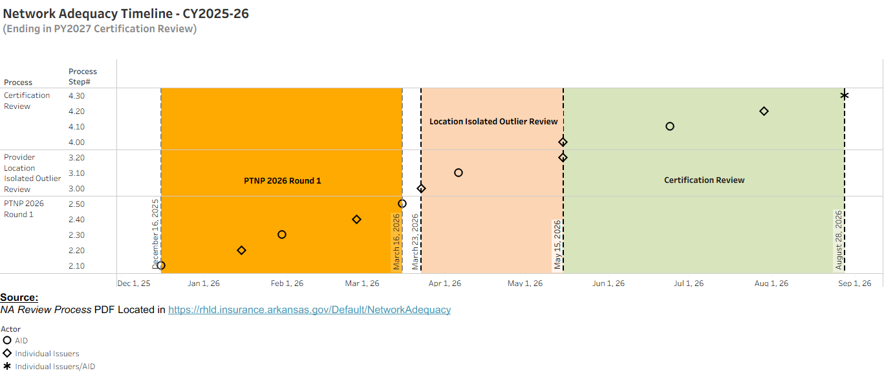
Timeline visualization from NA Process document (where CCIIO Standards are applicable)
We are here
Before: 15 days outlier review/address correction window
Small gap of only a week

Slide 8

Timeline visualization from NA Process document (where CCIIO Standards are applicable)
Now: 39 days outlier review/address correction window
Critical deadline for issuers –
One issuer’s delay will cause problems for all issuers.
PY2027 Network Adequacy data (using CMS-CCIIO’s PY2026 Network Adequacy template)
PY2027 Network Adequacy data (using CMS-CCIIO’s PY2027 Network Adequacy template)

Slide 9
Agenda
Introductions & Housekeeping.
Overview of where we are.
Timeline.
PBM Updates.
Provider Address Quality Precheck.
Recap of the Isolated Provider Location Outlier process.
Objection Feedback.
What’s different in the Current Finalized PTNP?
PTNP 2026 Round 1 data maintenance process .
Some observations from the last round.
Significance & Deadlines.
Q&A

Slide 10
How does the PTNP 2026 Round 1 dovetail into PBM NA Review?
PBM data processing starts after March 1
Pharmacies* finalized in PTNP is used
*Retail pharmacies only

Slide 11
PBM Template Changes Are Coming
One template.
Multiple data tabs instead of multiple templates with a single data tab.
Exact same data - Except we are dropping NAIC Code required as the first column of every table in the past.
Validation incorporated for common errors found in the past.
Templates must be validated and free of errors before submission.
Template details will be published on or before January 2, 2026 in PBM Network Adequacy web-location: https://rhld.insurance.arkansas.gov/PBMRegulation

Slide 12
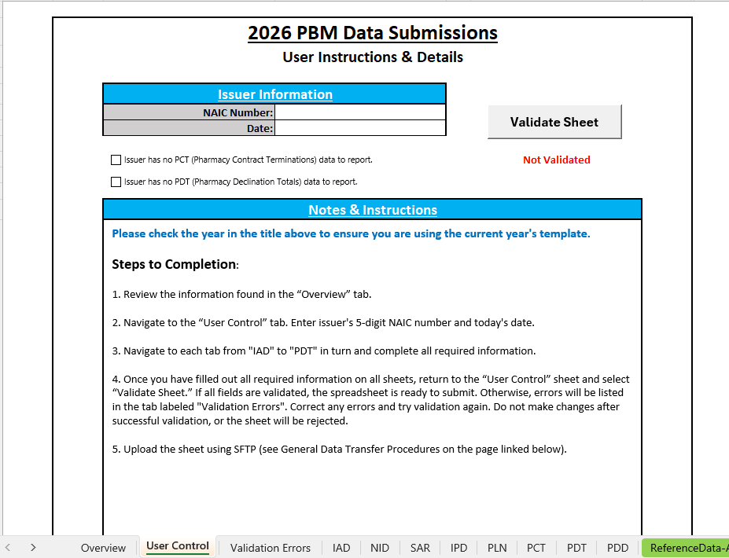
New PBM Data Template
Validation Button
Checkbox for optional data tabs
Multiple tabs

Slide 13
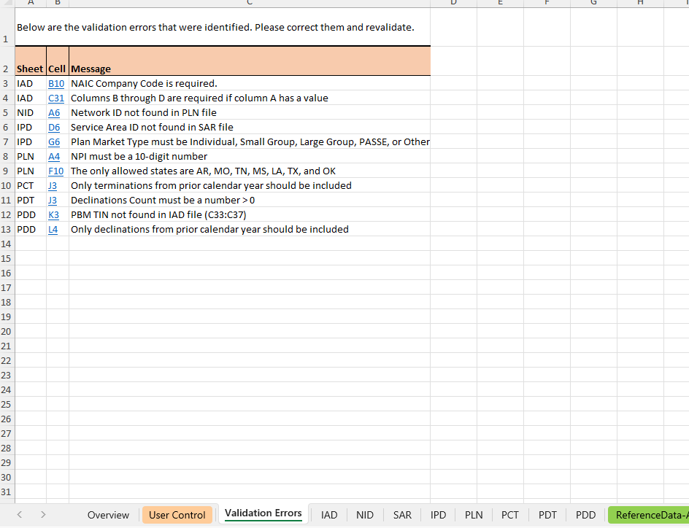
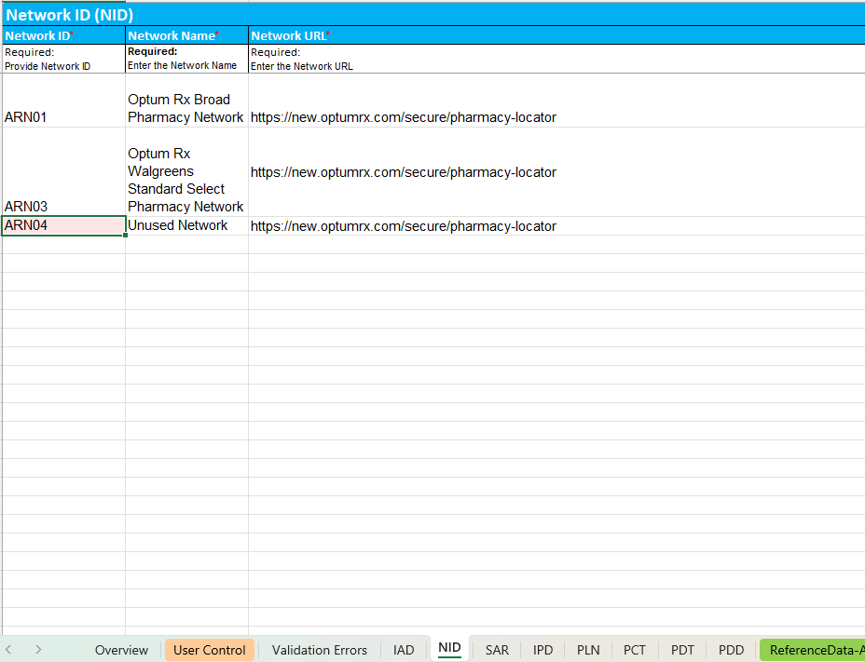
Validation Errors tab (in case of errors)
Upon clicking on the cell

Slide 14
Agenda
Introductions & Housekeeping.
Overview of where we are.
Timeline.
PBM Updates.
Provider Address Quality Precheck.
Recap of the Isolated Provider Location Outlier process.
Objection Feedback.
What’s different in the Current Finalized PTNP?
PTNP 2026 Round 1 data maintenance process .
Some observations from the last round.
Significance & Deadlines.
Q&A

Slide 15
Isolated Outlier Provider Address
1 mile
Isolated Outlier Address
Address of a provider reported by only one issuer group.
No other provider of the same type around 1 miles
(Relatively higher likelihood of influencing the ideal network of a provider type – favoring the reporting issuer group)

Slide 16
A reminder on “Why this process?”
Inexpensive correction opportunity:
Despite efforts, incorrect provider addresses remains a reality in issuer databases. Each issuer in Arkansas alone has tens of thousands of practice addresses. With the sheer volume, some incorrect addresses may fall through the cracks in issuer’s verification processes. The Isolated Outlier process makes available to issuers a tiny subset of practice addresses that have a higher likelihood of being incorrect – by the simple fact that they are outliers.
(In the first year this process was implemented, some issuers reported back error yields upwards of 50%.)
Enabling efficiencies in regulatory activities for everyone:
In Arkansas neither the regulator, nor issuers waste time with an inundation of “providers are not available” justifications because of the way in which AID issues an objection. Objections are issued only when both of the following conditions are met
An issuer is deficient per statutory requirements in a county and
Competitive data shows improvement is possible.
Deficiencies of each network is compared against an “ideal network” for each provider-type built by aggregating all practicing locations reported by all issuers for all providers existing in the PTNP within a provider-type.
The Isolated Outlier process ferrets out provider addresses that has a higher likelihood of incorrectly making the competing issuers look bad. If these addresses are not carefully reviewed and corrected as required, inefficiencies are introduced into the regulatory ecosystem. All competitors may waste resources researching deficiency objections that they may not have received in the first place (had incorrect outlier addresses been resolved). The regulator must then deal with all the justifications to a potentially unnecessary objection and start corresponding with the offending issuer.

Slide 17


Isolated-Outlier Provider Location Process
NA Template
(Detailed Data. NPI & Practicing locations)
Provider locations
Provider classifications
Current Finalized Provider Type NPI Pool (PTNP)
(Provider classifications vetted by the industry)
AID’s Isolated-Outlier provider location detection
Outlier Addresses
Issuers responsibility
Review reports carefully and update provider databases as necessary. Perform this in a timely manner so that the NA data submitted for certification review has these corrections.
Customized for each issuer
Outlier Address Reports
For Issuer Review

Slide 18
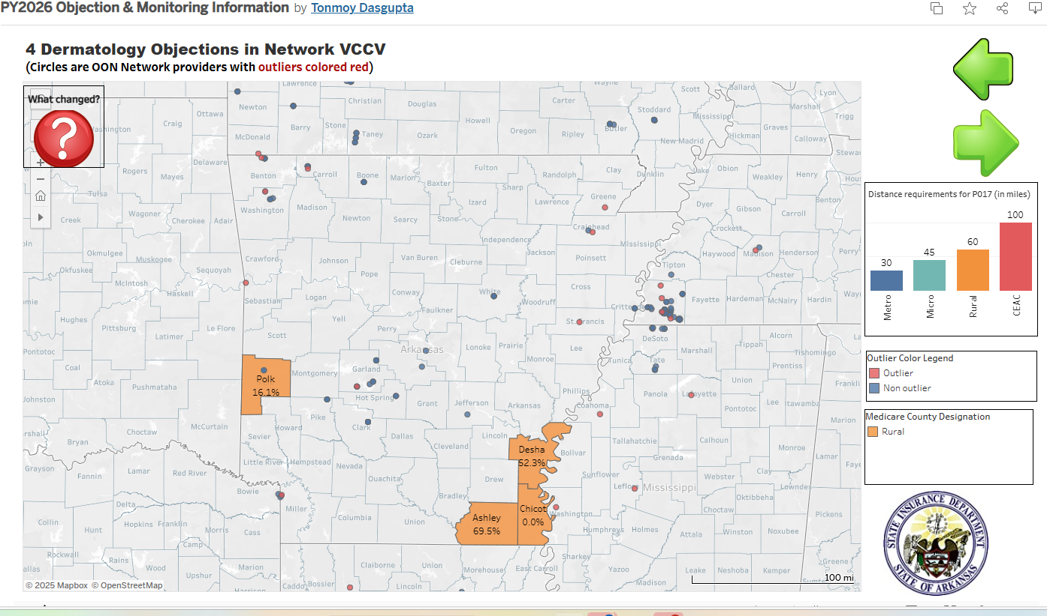


Unresolved Isolated Outliers are highlighted in Objection Visualizations
Outliers! Let’s check if someone goofed up creating problems for us in 3 counties!
Hmmm! That could be my Polk County solution…
Issuer receiving Objection

Slide 19
Issuer responsibilities in Isolated Outliers processing
Submit PY2027 provider practicing location data no later than Thursday March 26 Monday, March 23, 2026.
The data submitted should be as close to, if not identical to the PY2027 data that would be submitted in SERFF around mid-May for Certification.
Use CMS-CCIIO’s PY2026 Network Adequacy template as the PY2027 templates from CMS-CCIIO may not be available. Rename the template suitably identifying your company/group (suggested <NAIC Code>-<Abbreviated Company Name>-NetworkAdequacyTemplate.xlsm).
Upload this data to the AID file upload url https://rhld.insurance.arkansas.gov/NAProvidersUpload. Please notify your Compliance Officer when done.
After AID furnishes in the Isolated Outlier reports customized for each issuer/issuer group, carefully review each provider address for accuracy/currency and update provider databases as necessary. Perform this in a timely manner so that the NA data submitted for certification review around mid-May reflects these corrections.
For enabling the issuers to complete the above, AID has committed to making available the Isolated Outlier reports to the issuers on or before Monday, April 6, 2026.

Slide 20
Agenda
Introductions & Housekeeping.
Overview of where we are.
Timeline.
PBM Updates.
Provider Address Quality Precheck.
Recap of the Isolated Provider Location Outlier process.
Objection Feedback.
What’s different in the Current Finalized PTNP?
PTNP 2026 Round 1 data maintenance process .
Some observations from the last round.
Significance & Deadlines.
Q&A

Slide 21
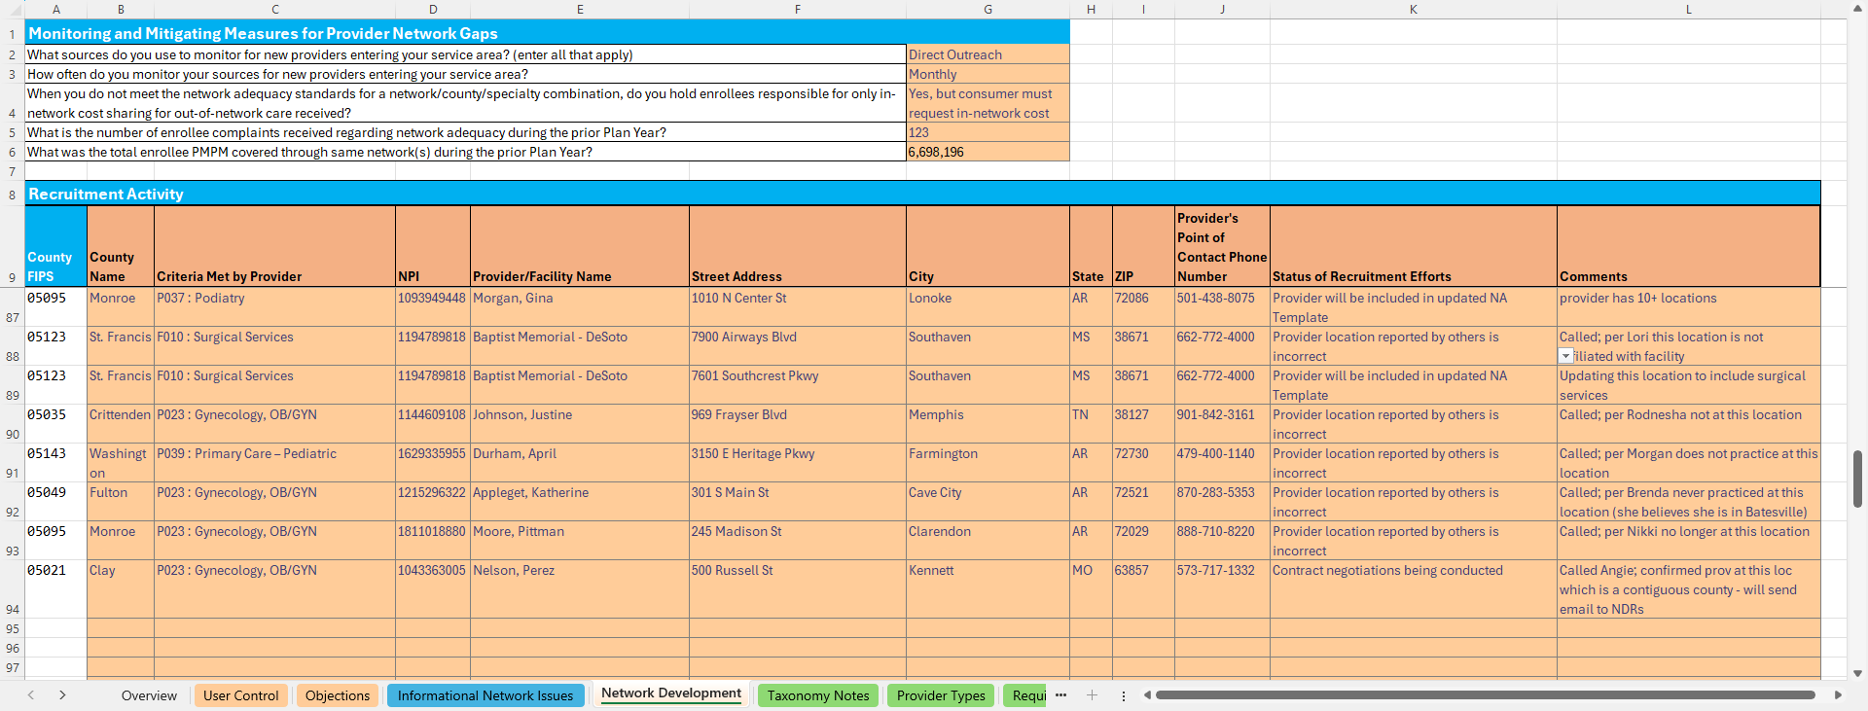
Justification Template

Slide 22
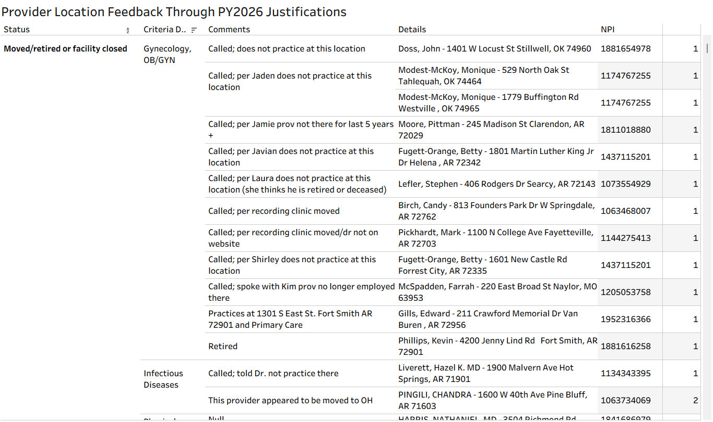
A sampling of potentially faulty locations

Slide 23
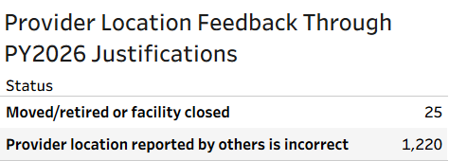
Issuers concluded that some of the PY2026 objections were due to faulty provider data from others. They have communicated such data using the above two Justification Template Status.
Such competitor research efforts should be viewed as a potential opportunity for provider data corrections.
Issuers can use the Comments behind each location pushback to judge what to prioritize for correction.
If you had reported an NPI in PY2026 with either of the two Status above, you will receive a spreadsheet for each of the contested address for review and potential correction.
AID will provide Issuers this feedback spreadsheet on or before March 23, 2026 (The start of the Isolated Outlier process).
The numbers in the table above are significantly bloated with various duplications. AID is working to resolve these duplicates.
Several “Provider location reported by others is incorrect” Status was used to convey incorrect PTNP classifications (Since AID had overlooked the provisioning of an appropriate Status to cover this).

Slide 24
Agenda
Introductions & Housekeeping.
Overview of where we are.
Timeline.
PBM Updates.
Provider Address Quality Precheck.
Recap of the Isolated Provider Location Outlier process.
Objection Feedback.
What’s different in the Current Finalized PTNP?
PTNP 2026 Round 1 data maintenance process .
Some observations from the last round.
Significance & Deadlines.
Q&A

Slide 25
What’s Different?
Besides the usual issuer-initiated data maintenance…
Pharmacies are back.
Acute Inpatient Hospitals aka General Acute Care Hospitals (GACH) list now maintained by CMS-CCIIO
The “seeding” issues observed in the PTNP when pivoting from Arkansas to CCIIO provider-type definitions for PY2026 has been resolved.
Of the 2,344 AID-suggested “removals” 2,223 were deemed acceptable through the PTNP process (95% acceptance).

Slide 26
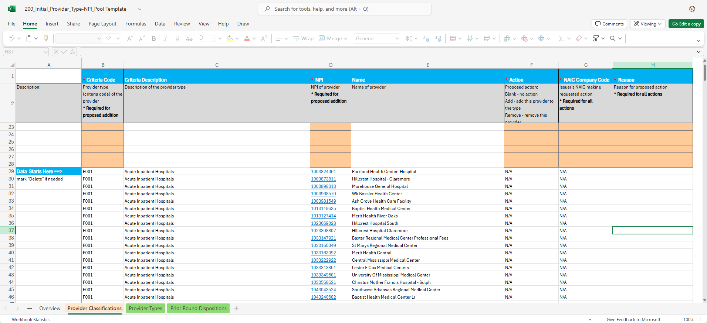
General Acute Care Hospitals (GACH)
Maintained by CMS-CCIIO– not through the PTNP process.
CMS-CCIIO had developed an elaborate process of maintenance of the list.
The number of NPIs for GACHs has jumped from 142 to 290, a remarkable 104% increase.
Some hospitals have multiple NPIs.
Since not under PTNP control, they appear in “Initial Template” without any orange-colored cell signifying possible “Input” from issuers.

Slide 27
Pharmacies
Several retail pharmacies were found to be incorrectly classified either in the
NPI Registry (NPPES data) or
NCPDP database.
Decision was made to move the Pharmacies back to the PTNP for better data maintenance. The Current Finalized PTNP list has 1291 pharmacies after vetting through the last PTNP Round.
Pharmacy is not a CCIIO Provider type. This provider type will only be used in the PBM Regulation side. Therefore, only issuers using PBMs need participate in this provider type maintenance.
Going forward, issuers are advised NOT to add pharmacy(ies) into the PTNP list only because they are classified Community/Retail in either of the databases listed in 1) above. Independently verify directly with the pharmacy if they are Community/Retail.

Slide 28
Pharmacies- contd.
Vetting a pharmacy as Community/Retail.
Never ask a pharmacy if they are “Retail”. Local/State pharmacy boards may issue a retail license that does not align with Medicare’s interpretation of a Community/Retail pharmacy. Medicare’s interpretation is applicable in PBM regulation.
Contact the pharmacy directly with the questions
Would you entertain anyone from the public walking into your pharmacy with a valid prescription?
Do you carry generally the range of medications a Walgreens, Walmart Pharmacy or Kroger Pharmacy would? Or do you only carry specialty medications or equipment.
The answer to 1) and 2) needs to be “Yes”.

Slide 29
Agenda
Introductions & Housekeeping.
Overview of where we are.
Timeline.
PBM Updates.
Provider Address Quality Precheck.
Recap of the Isolated Provider Location Outlier process.
Objection Feedback.
What’s different in the Current Finalized PTNP?
PTNP 2026 Round 1 data maintenance process .
Some observations from the last round.
Significance & Deadlines.
Q&A

Slide 30
Some observations from the last round
The Good:
Realizing the significance of the PTNP, participation has ramped up.
The “Reasons” provided are increasingly helpful to AID in making more informed dispositions.
The not-so-Good:
The “Reason” for any suggestion or response usually needs to reflect research beyond the NPI Registry taxonomy. Why? The very reason we engage in the PTNP process is because the NPPES database (NPI Registry) provider classification data is imperfect, and not good enough for regulatory purposes. The PTNP process attempts to correct errors therein to build the Current Finalized Provider Type-NPI Pool.
Need clear understanding of provider types that allow nurses. Details in the next slide.

Slide 31
Summarizing CCIIO’s rules on APRNs & PAs
(Details documented in the Taxonomy Notes tab within the file Provider Type Taxonomic Descriptions located in https://rhld.insurance.arkansas.gov/Default/NetworkAdequacy.)
APRNs (appropriately qualified) are only allowed in three provider types
P038 Primary Care – Adult
P039 Primary Care – Pediatric
P033 Outpatient Clinical Behavioral Health
Psychiatry APRNs (but not Psychiatry MDs !) are allowed in
P033 Outpatient Clinical Behavioral Health
PAs are only allowed in two provider types
P038 Primary Care – Adult
P039 Primary Care – Pediatric

Slide 32
Agenda
Introductions & Housekeeping.
Overview of where we are.
Timeline.
PBM Updates.
Provider Address Quality Precheck.
Recap of the Isolated Provider Location Outlier process.
Objection Feedback.
What’s different in the Current Finalized PTNP?
PTNP 2026 Round 1 data maintenance process .
Some observations from the last round.
Significance & Deadlines.
Q&A

Slide 33
PTNP 2026 Round 1 Significance & Deadlines
This PTNP round will impact Network Adequacy review for PY2027. As in the past,
You would not get credit for a NPI within your networks if that NPI does not exist in the PTNP.
An incorrectly classified NPI may not give you credit in the provider type you are seeking OR could work against you if the NPI is not in your network.
In Stage 1 (Addition/Removal suggestions) recommend not attempting to boil the ocean. Instead
Do review your PY2026 objections responses for “incorrect classification” or any PTNP related justifications.
Review incoming providers for PTNP impact.
Review reasons behind outgoing providers (retired/death/moved to distant state?)
Do try to provide brief but evidentiary “Reason”
In Stage 2 (Voting on suggestions)
Do attempt to boil the ocean at this stage.
Prioritize sparse provider types and provider types you may have received objections on in the prior year.
Do try to provide brief but evidentiary “Reason”

Slide 34
PTNP data maintenance Round 1
Details available in NA Review Process.pdf
Finalized Provider Type-NPI Pool (AID)
Expect: Mar 16, 2026
Initial Provider Type NPI Pool (AID)
Due: Feb 27, 2026
Votes by individual carriers (Issuers)
Expect: Jan 30, 2026
Next up: Jan 15, 2026
Addition-Deletion Suggestions by individual carriers (Issuers)
Industry Provider Type Addition-Deletion suggestions (AID)
Stage 1
Stage 2

Slide 35






http://rhld.insurance.arkansas.gov/Default/NetworkAdequacy
2026 Round 1 Initial Provider Type-NPI Pool
(Available since December 1, 2025)
Add? Delete?
Blue Cross Experts
“20260115_83470_BCBS_Provider_Type_NPI_AddDelete.csv”
(Due Jan 15, 2026)
AID Secure FTP Server
Stage 1: “Suggestion for changes” stage using BCBS as an example

Slide 36


http://rhld.insurance.arkansas.gov/Default/NetworkAdequacy
"Industry Provider Type Addition-Deletion
suggestions" (Expect Jan 30, 2026)
To agree or not to agree on this addition and that removal?
Ambetter Experts
“20260227_80799_Ambetter_ObjectionVote.csv”
(Due Feb 27, 2026)
AID Secure FTP Server
Stage 2: “Voting” stage using Ambetter as an example

Slide 37

Expectations from Issuers
Refer pdf document NA Review Process located in http://rhld.insurance.arkansas.gov/Default/NetworkAdequacy (NA website)
PTNP 2026 Round 1
Issuers provides suggestions for change. Due on January 15, 2026.
AID collects these suggestions and posts the consolidated information on NA website on January 30, 2026.
Issuers vote their agreement OR opposition to suggested changes by others. Due on February 27, 2026.
AID processes votes and updates the PTNPs on NA website on March 16, 2026.
Isolated Outlier Provider Location Process
Issuers upload PY2027 Network Adequacy data using CMS-CCIIO PY2026 Network Adequacy templates at the file upload web location https://rhld.insurance.arkansas.gov/NAProvidersUpload. Due on March 23, 2026.
AID provides the Isolated Outlier reports customized for each issuer by April 6, 2026.
Issuers review Isolated Outlier reports and correct provider addresses as needed in their databases. This must be done in time so that the PY2027 NA templates submitted for certification review in SERFF reflect the corrected provider addresses.
AID will use the updated PTNP data to review NA data submitted through SERFF for certification.

Slide 38
If you as an issuer, have an opinion about how Arkansas has implemented its network adequacy regulation please send an email at RHLD.DataOversight@arkansas.gov
We would welcome suggestions on how you may do things differently
What does not work well, etc.
We may in turn seek meetings with issuers one-on-one as resources permit.

Slide 39


Questions?
Email
RHLD.DataOversight@arkansas.gov
Or call
Tonmoy Dasgupta (501-773-0420) Cell

Slide 40
Appendix
Reference slides for new issuer personnel

Slide 41
New to THE Program?
Arkansas Network Adequacy Regulation

Slide 42
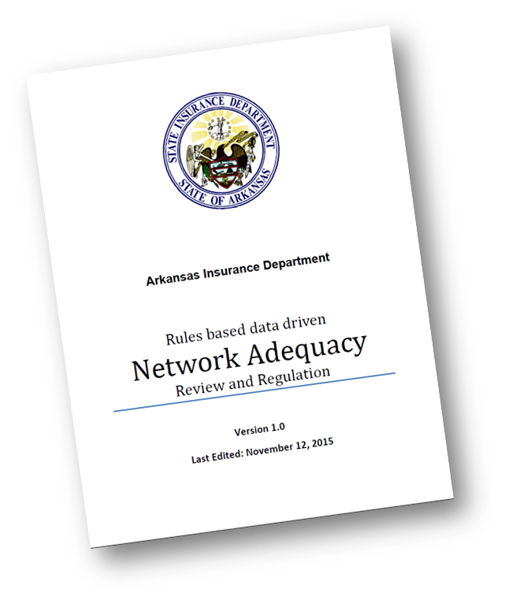
New to Arkansas NA Regulation Program?
Two important documents to read
Program details available at http://rhld.insurance.arkansas.gov/Default/NetworkAdequacy
“NA Review Process”
This document lays out NA activities for the coming plan year
Meeting slides and notes maintained in chronological order
Data specifications & templates updated at http://rhld.insurance.arkansas.gov/Info/Public/Templates
For data submission requirements refer “SERFF Network Adequacy Data Submission Instructions”
New issuers can call AID for an overview with Q&A.

Slide 43
How is data exchanged in the PTNP process?
From AID to issuers:
AID’s Network Adequacy (NA) webpage (http://rhld.insurance.arkansas.gov/Default/NetworkAdequacy)
For file names refer Network Adequacy Review Process.pdf located in the same webpage.
From issuers to AID:
Delivery to AID’s secure FTP servers following instructions in “General Data Submission Process to RHLD” located at http://rhld.insurance.arkansas.gov/Info/Public/Templates. For file naming conventions during the two stages of issuer feedback refer Network Adequacy Review Process.pdf located in AID’s NA webpage.
Data submissions from issuers explained with examples in later slides.

Slide 44
AID Disposition Details
AID provides detailed information on the outcome of the voting stage.
This makes available cases where AID had to
wade in to settle tie breakers OR
reverse a popular vote based on a strong(er) reason provided by the minority (few cases)

Slide 45
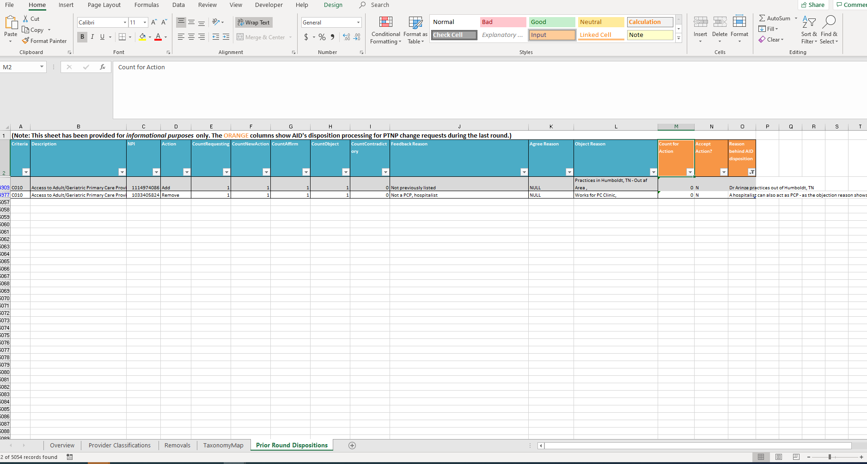
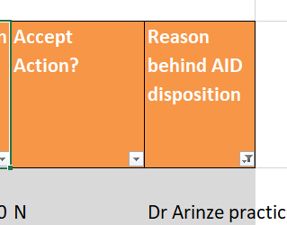
Initial Provider Type NPI pool template

